Slide 1

CSCI-3753: Operating Systems Fall 2019
Biljith Thadichi
Department of Computer Science University of Colorado Boulder
Slides based on presentation by Abigail Fernandes

Slide 2
Programming Assignment 2
2

Slide 3
LKM – Quick Recap
What are the two main functions required in a LKM code?
How do you load the module into the kernel? How do you unload the module from the kernel?
3

Slide 4
PA2 – Character Device Driver
Programs
User Space
Open, Read, Write, Close, Seek
Device File (/dev/<name>)
mknod –m <permission>
<device_file_location>
<type of driver>
<major number>
<minor number>
File Operations
Device Driver
<name>
<major>:<minor>
<minor>
Kernel
Physical Device
4

Slide 5
PA 2
Create a Device Driver Module (LKM)
Implement file operations (open, seek, read, write, release)
Make and load the module
Create a Device File for this Device
Test program that will allow you to perform different operations on the test file.
5

Slide 6
Creating Device File for a Device Driver
sudo mknod -m <permission> <device_file_location> <type_of_driver>
<major_number> <minor_number>
Ex. sudo mknod -m 777 /dev/simple_character_device c 240 0
6

Slide 7
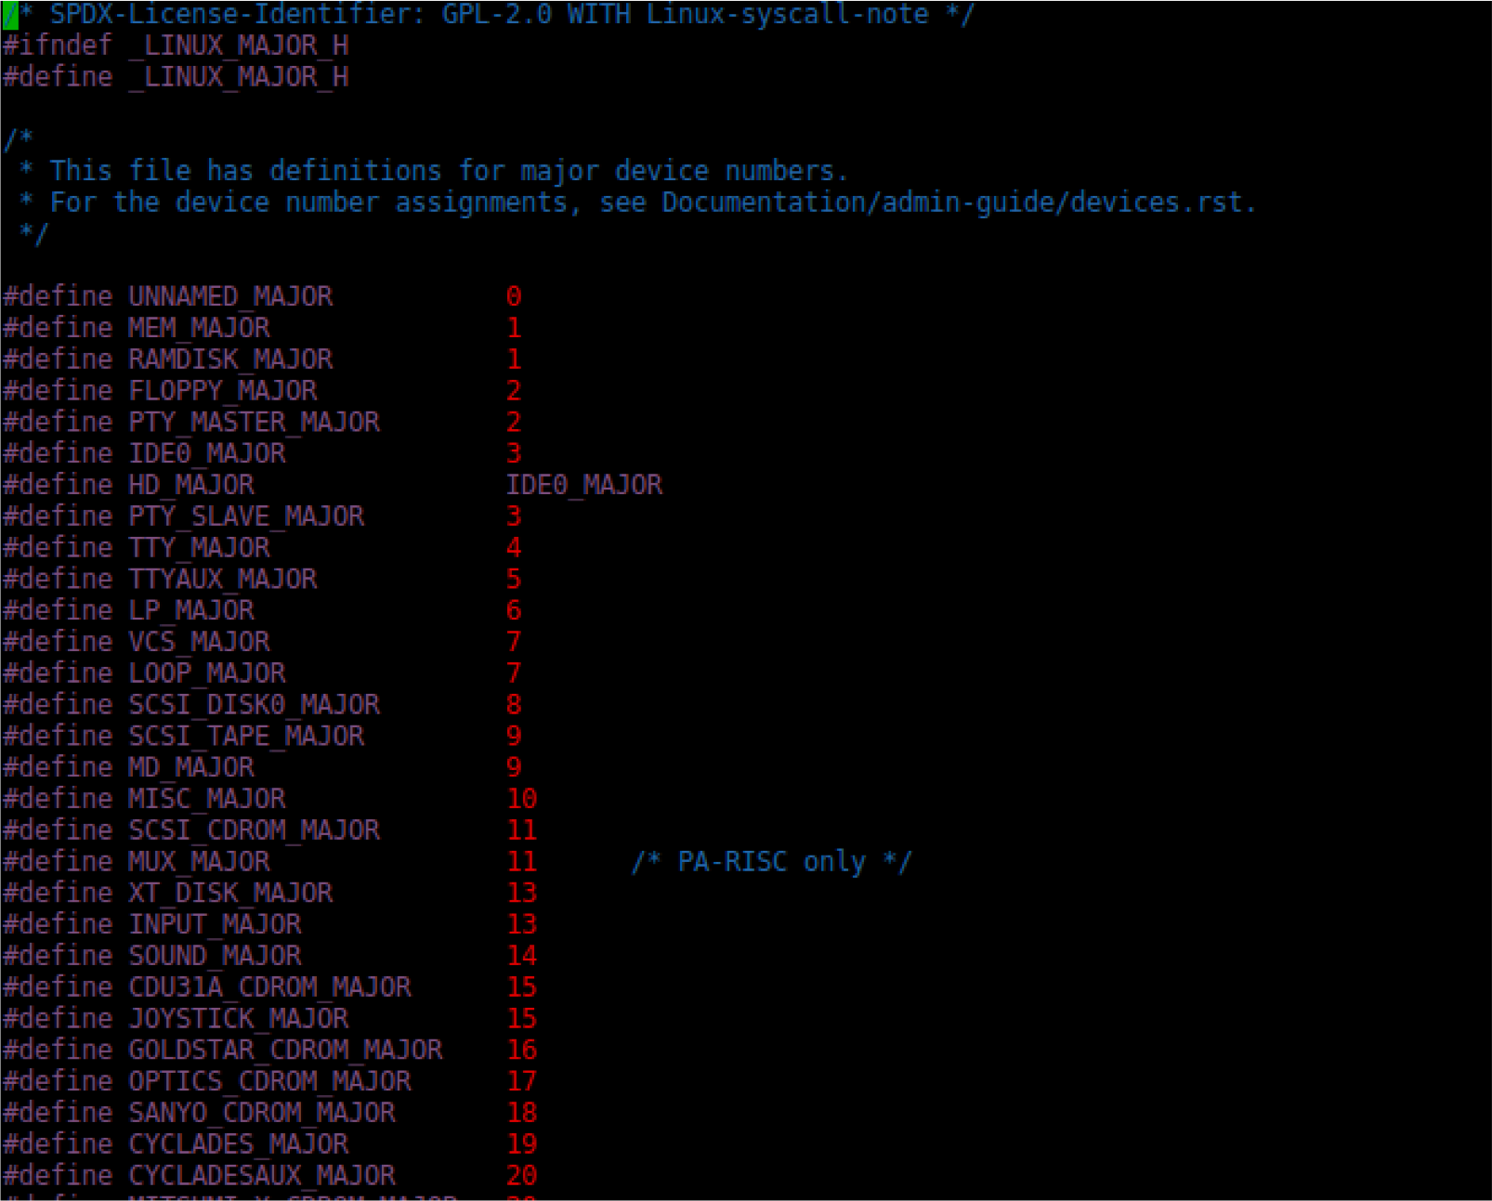
System Device Major Numbers
vim /home/kernel/linux-hwe-4.15.0/include/uapi/linux/major.h
7

Slide 8
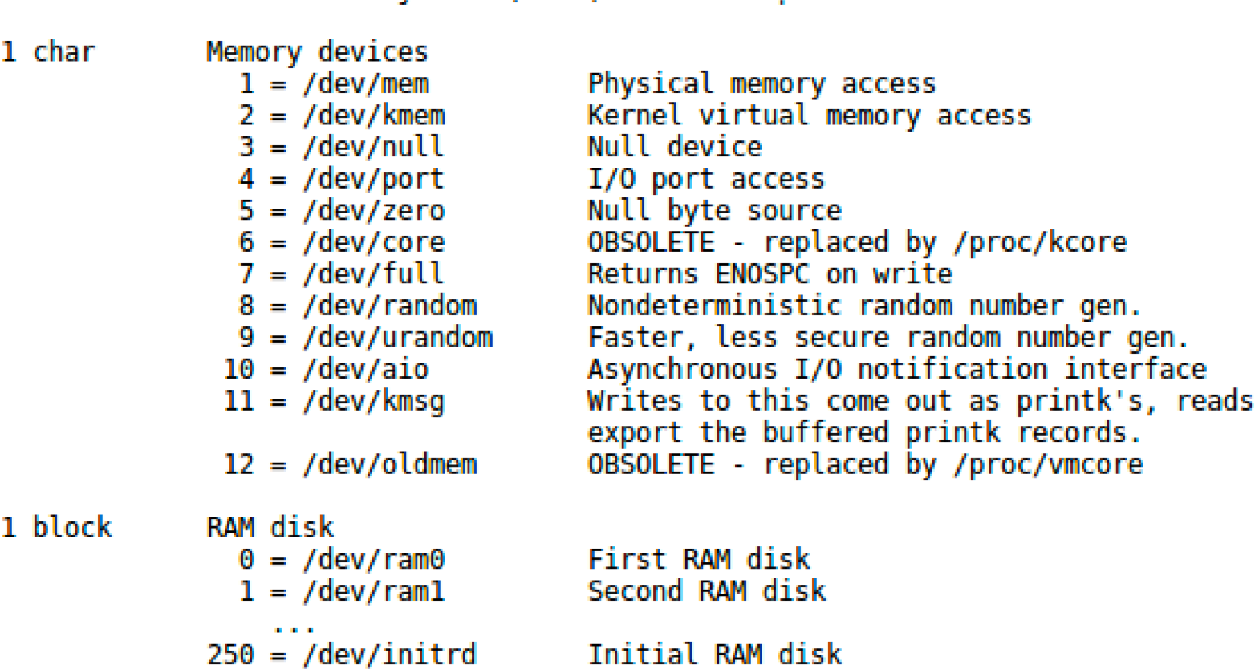
Documentation for devices
See Documentation/admin-guide/devices.txt -> Current devices and major numbers
vim /home/kernel/linux-hwe-4.15.0/Documentation/admin-guide/devices.txt
8

Slide 9
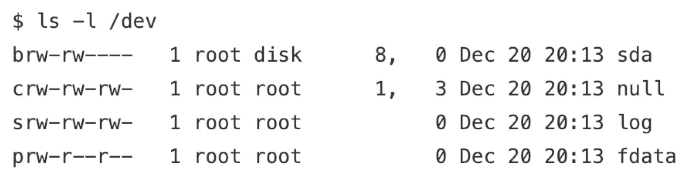
/dev Directory
Device Type
Permissions
Owner
Group
Major Device Number
Minor Device Number
Timestamp
Device Name
9

Slide 10
register_chrdev()
Major number
Unique name
Pointer to file operations struct
10

Slide 11
File Operations Data Structure
Defined in /linux/fs.h
vim /lib/modules/$(uname -r)/build/include/linux/fs.h
The kernel uses the file_operations structure to access the driver’s functions
Each field in the structure must point to the function in the driver that implements a specific operation, or be left NULL for unsupported operations.
11

Slide 12
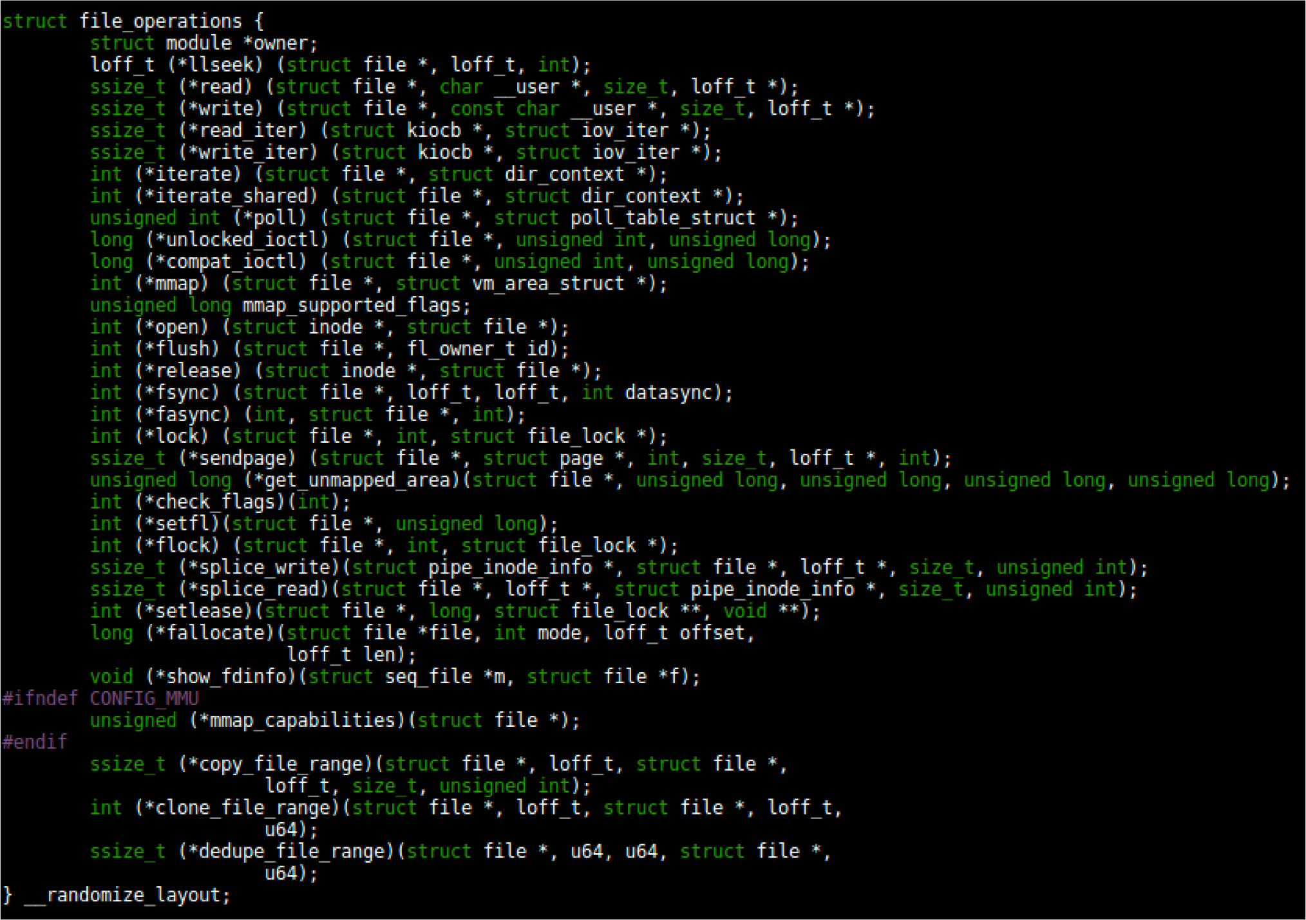
File Operations Data Structure
12

Slide 13
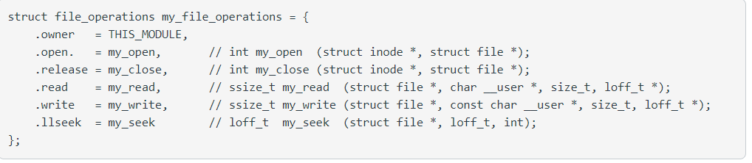
File Operations Data Structure
13
Notes:
Designated initializer

Slide 14
PA2 – Requirements
Dynamically allocate kernel buffer to store the data written by the user
kmalloc()
Allocate memory for objects smaller than page size in the kernel at initialization time
kfree()
Free memory previously allocated using kmalloc() before exiting
Offset pointer in read/write function
Use copy_to_user and copy_from_user inside the device driver.
14

Slide 15
Processes and Threads

Slide 16
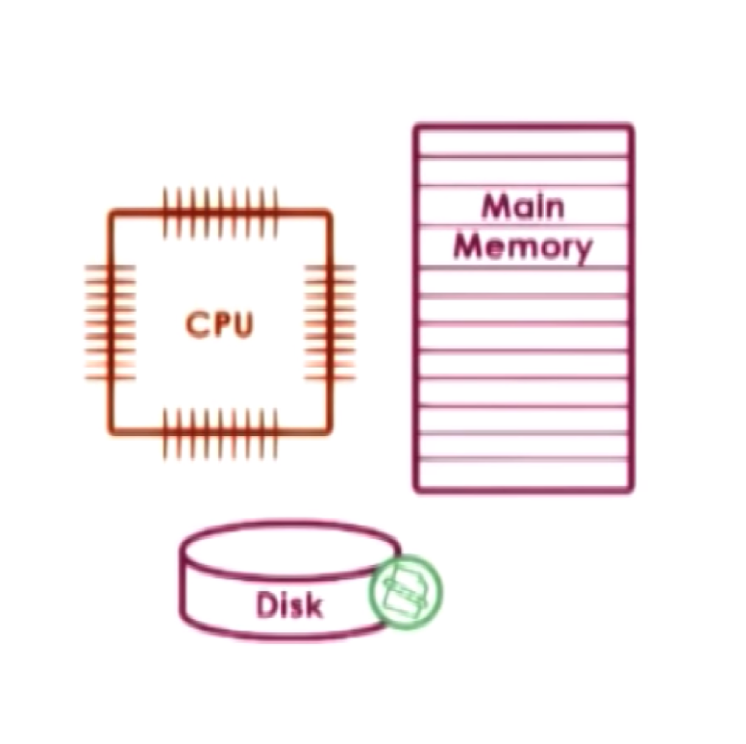
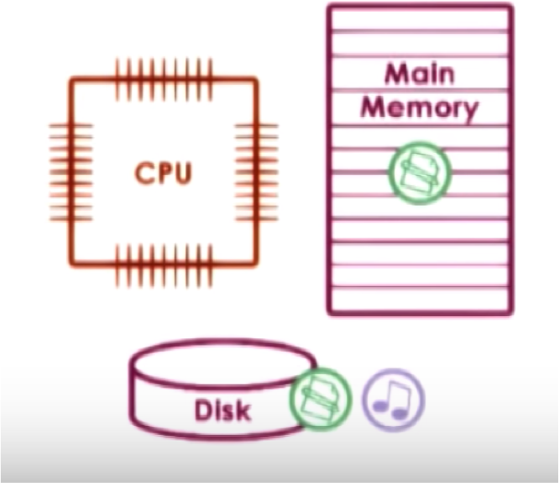
What is a process?
OS manages hardware on behalf of applications
Application = program on disk, flash memory (static entity)
Process – state of a program when loaded in main memory (active entity)
Notes:
Can have two processes run the same program. They might have the same text section but they are two different processes.

Slide 17
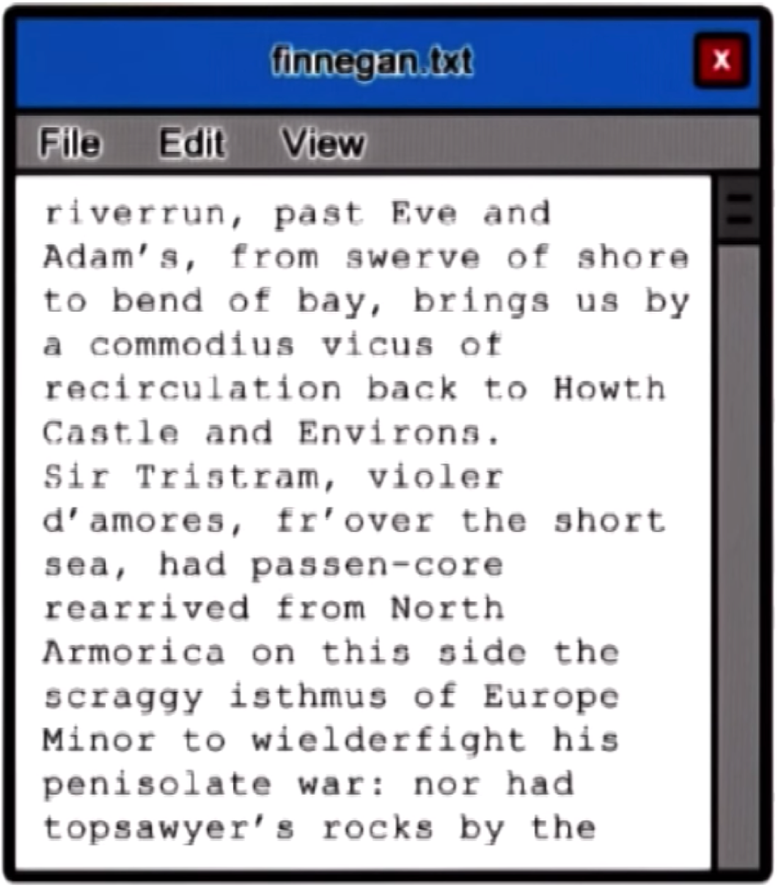
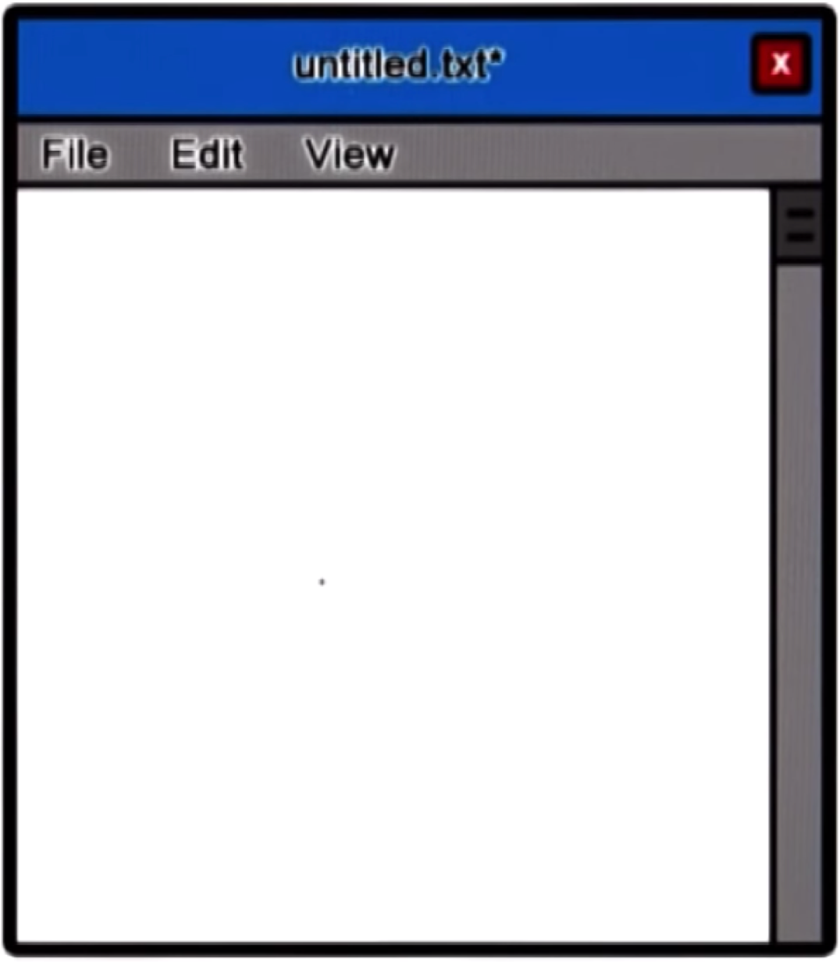
Example of a process

Slide 18
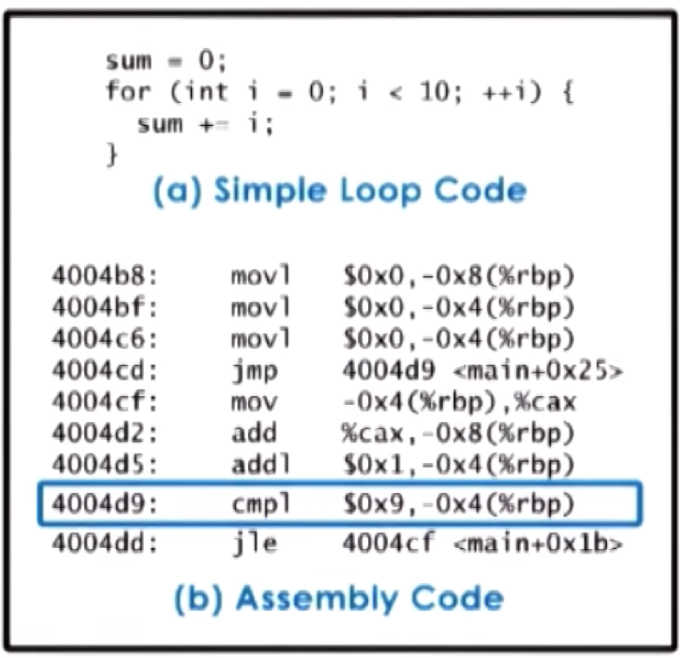



How does the OS know what a process is doing?
Program Counter
CPU Registers
Stack Pointer
PC
Stack Pointer
Register
Main Memory
Process Control Block
CPU

Slide 19
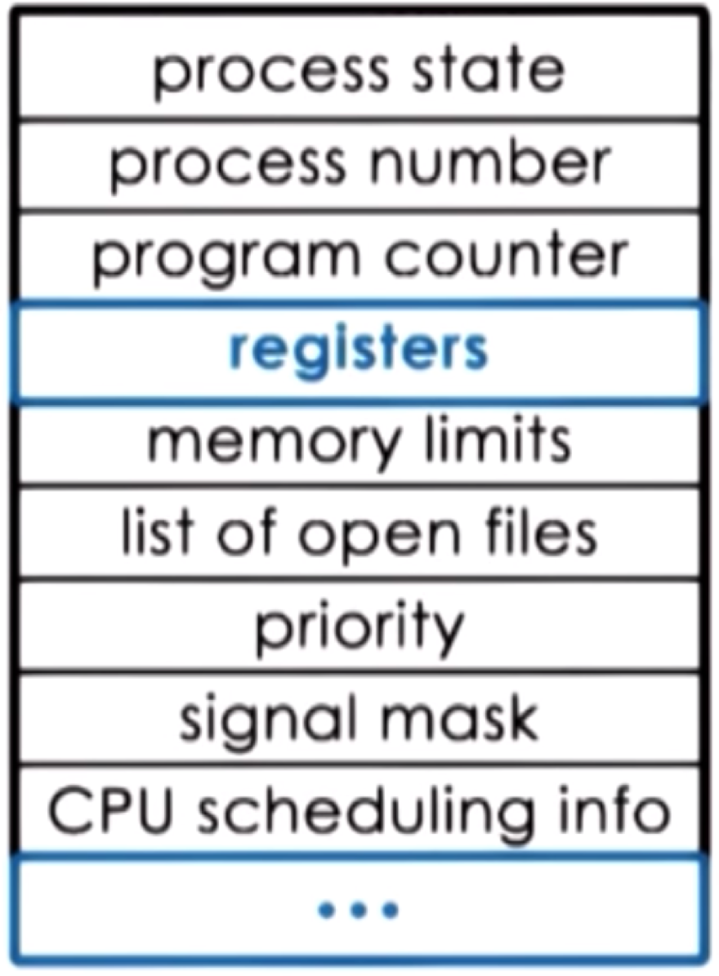
Process Control Block
PCB created when process is created
Certain fields are updated when process state changes
Other fields change very
frequently
Notes:
Registers like program counter, accumulator, general purpose registers.
CPU scheduling info – Process priority, pointers to scheduling queues.

Slide 20
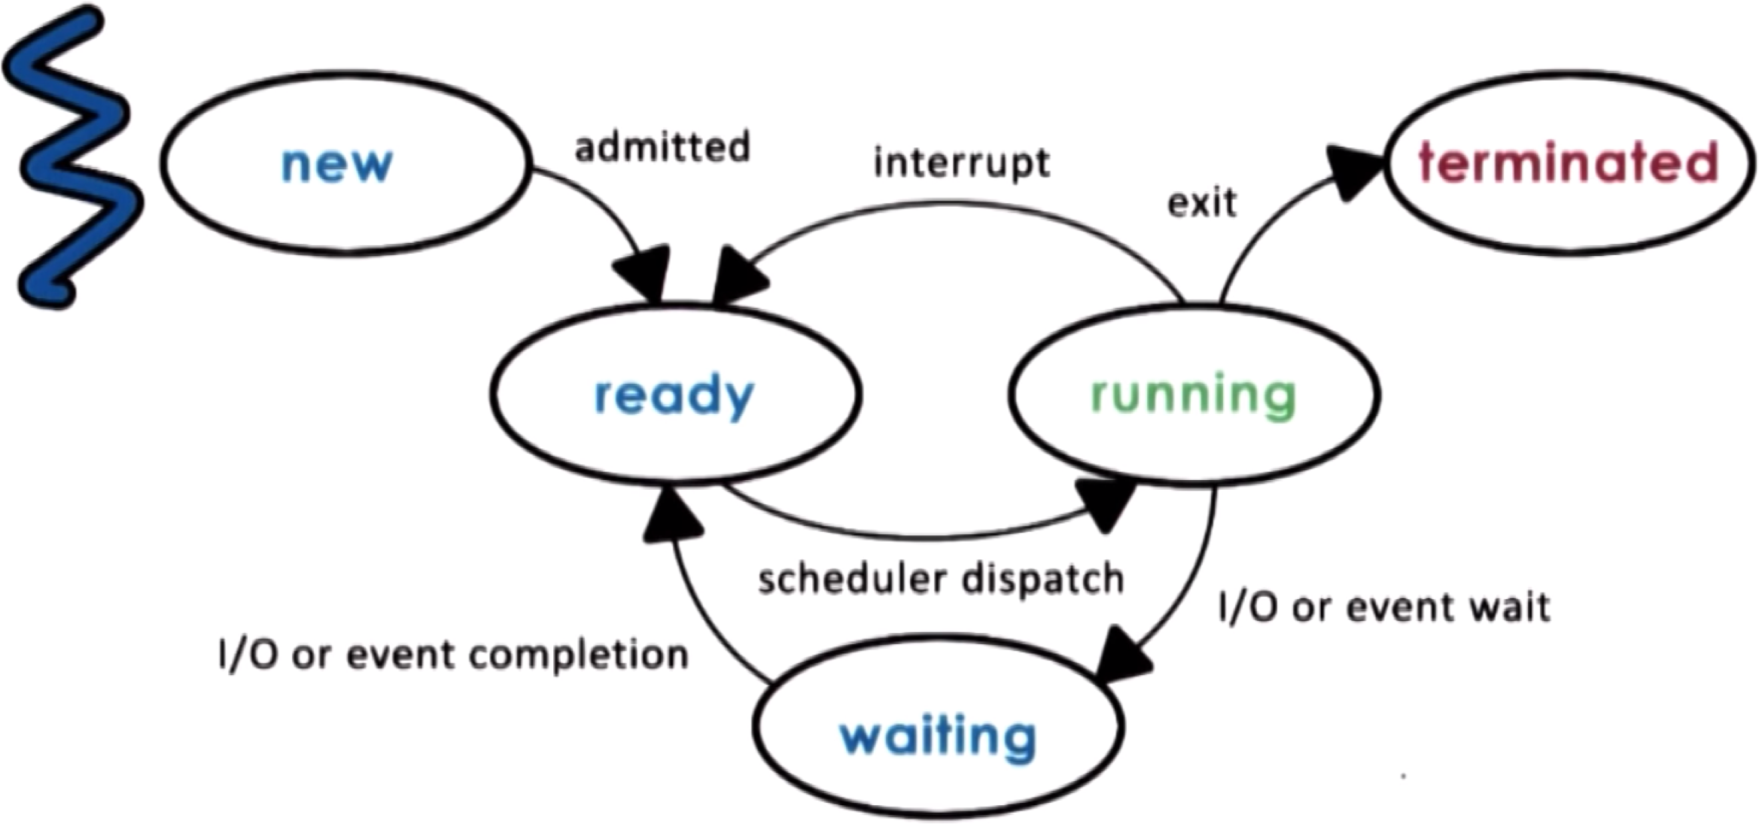
Process Lifecycle: States
Notes:
Only one process can be running on one processor at any given time on one CPU

Slide 21
Process Lifecycle: States
New: The process is being created.
Running: Instructions are being executed.
Waiting: The process is waiting for some event to occur (such as an I/O completion or reception of a signal).
Ready: The process is waiting to be assigned to a processor.
Terminated: The process has finished execution.

Slide 22
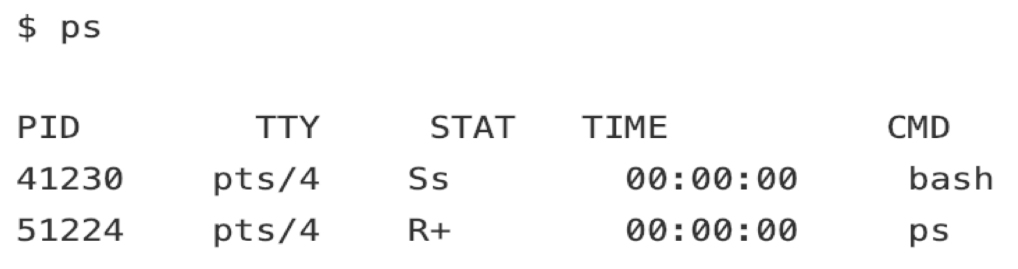
Processes
Have an ID associated with it called the process ID (PID)
ps command
PID: Process ID
TTY: Controlling terminal associated with the process
STAT: Process status code
TIME: Total CPU usage time
CMD: Name of executable/command

Slide 23
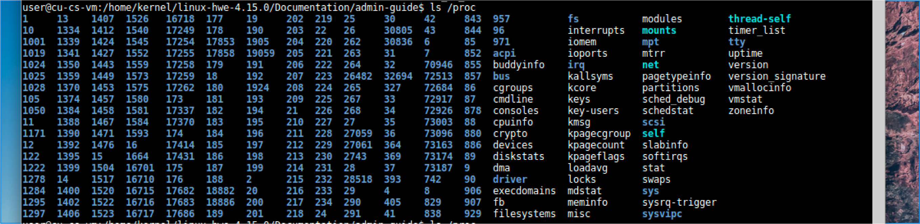
/proc directory

Slide 24
/proc directory
Contain virtual files and numbered directories corresponding to each running process
Directory names = process ids
When a process ends, its directory in /proc disappears automatically.
Files in a numbered directory
Cmdline
cwd
environ
fd
maps, statm, mem; stat, status
Notes:
https://www.linux.com/news/discover-possibilities-proc-directory/
The virtual files are owned by the person who ran the program.
cmdline: Contains the command that started the process, with all its parameters.
cwd: A symlink to the current working directory (CWD) for the process; exe links to the process executable, and root links to its root directory.
environ: Shows all environment variables for the process.
fd: Contains all file descriptors for a process, showing which files or devices it is using.
maps, statm, and mem: Deal with the memory in use by the process.
stat and status: Provide information about the status of the process, but the latter is far clearer than the former.

Slide 25
/proc directory
Some typical virtual files that provide
Hardware information
/proc/cpuinfo: identifies the type of processor used by your system
/proc/meminfo
File-related info
/proc/filesystems: displays a list of the file system types currently supported by the kernel
/proc/partitions
Kernel configuration parameters
/proc/cmdline: shows the parameters passed to the kernel at the time it is started
/proc/sys
Notes:
Talk about /proc/self

Slide 26
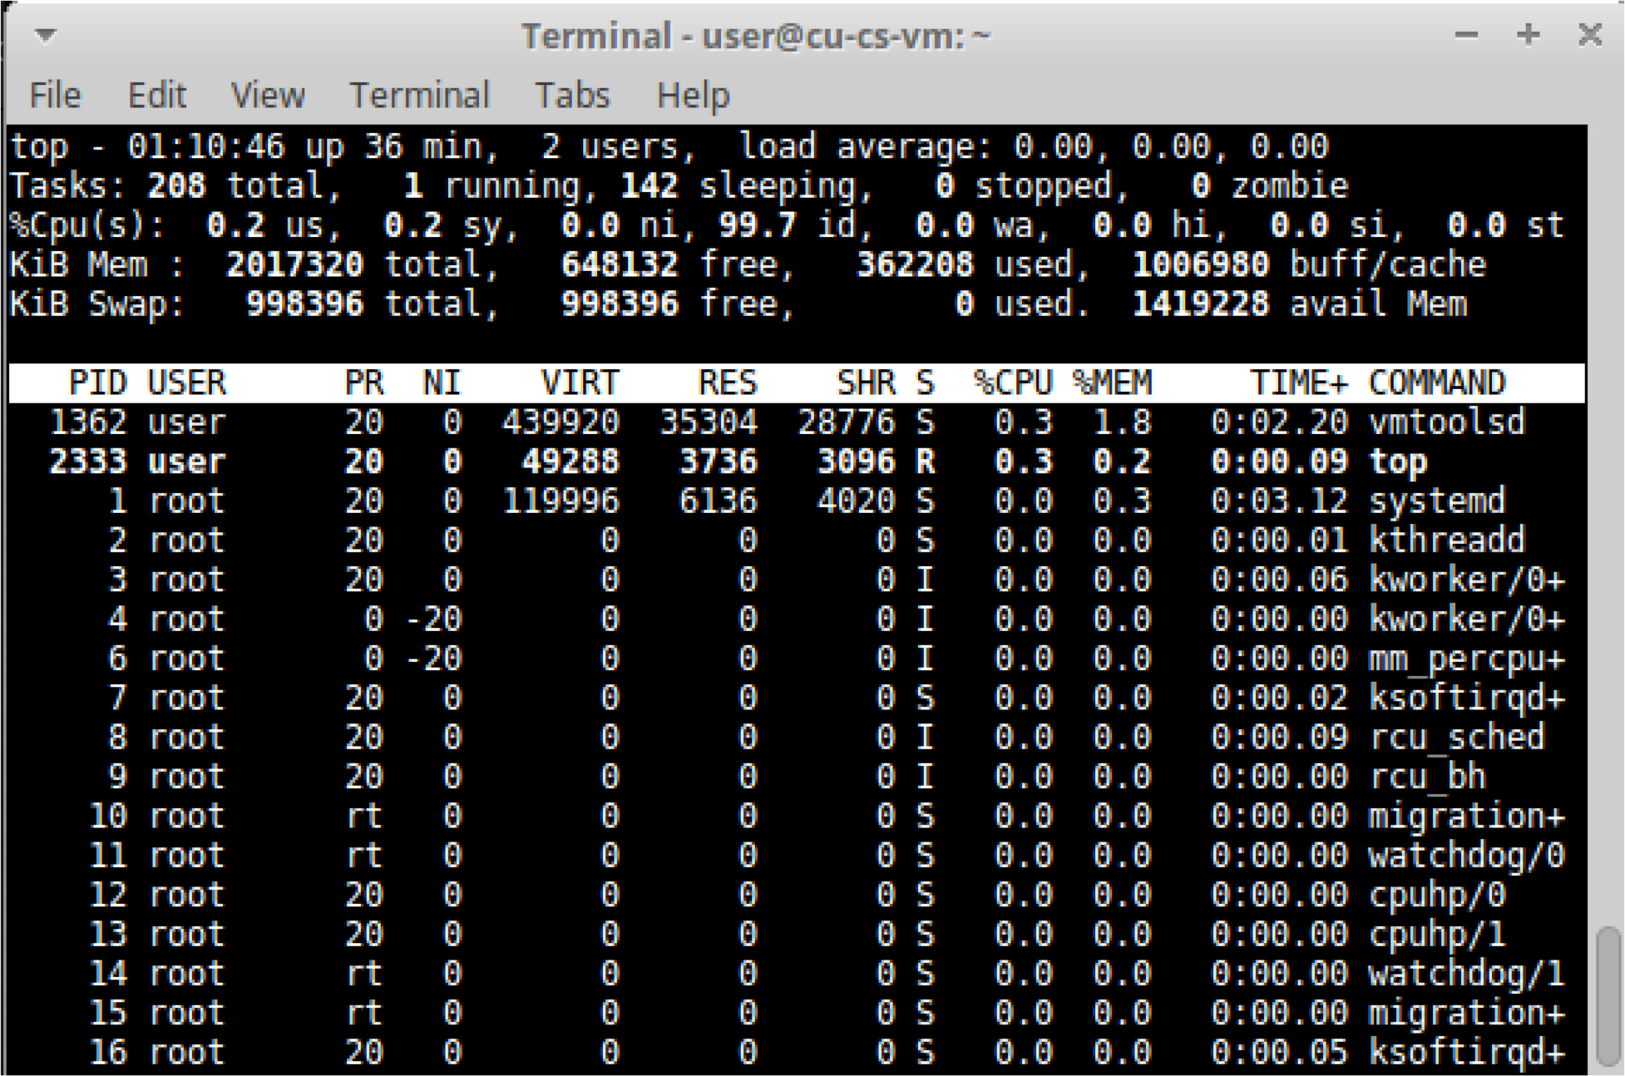
top command
Display a list of processes with their resource usage.

Slide 27
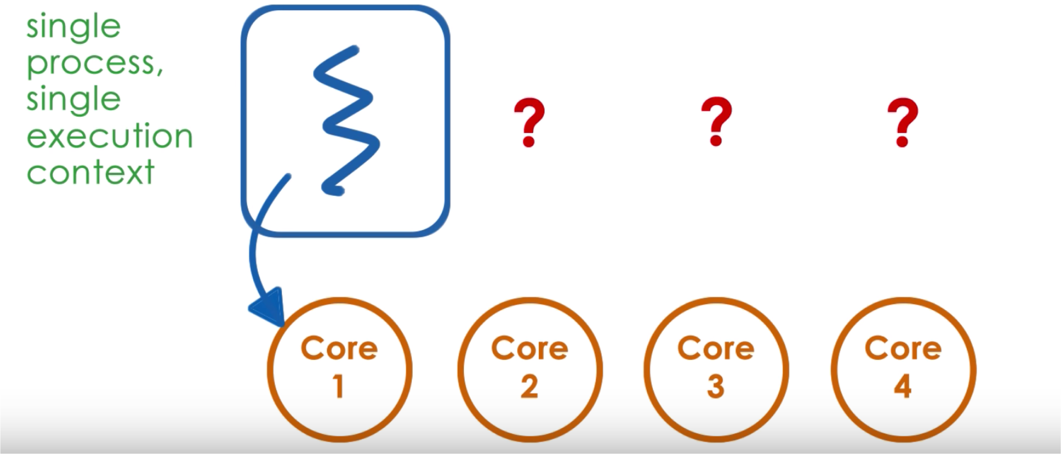
What if we have multiple CPUs

Slide 28
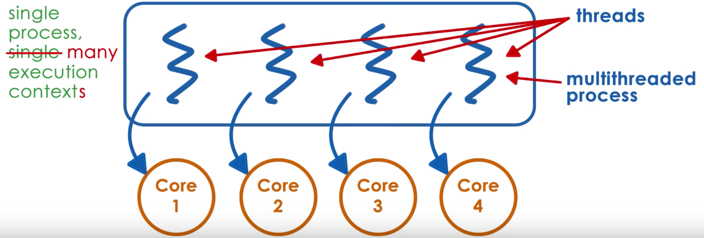
What if we have multiple CPUs

Slide 29
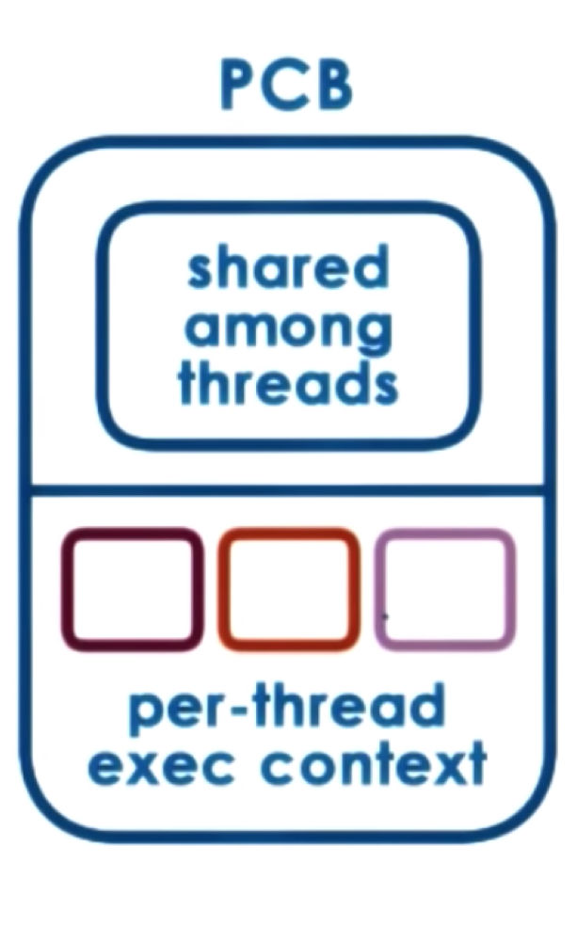
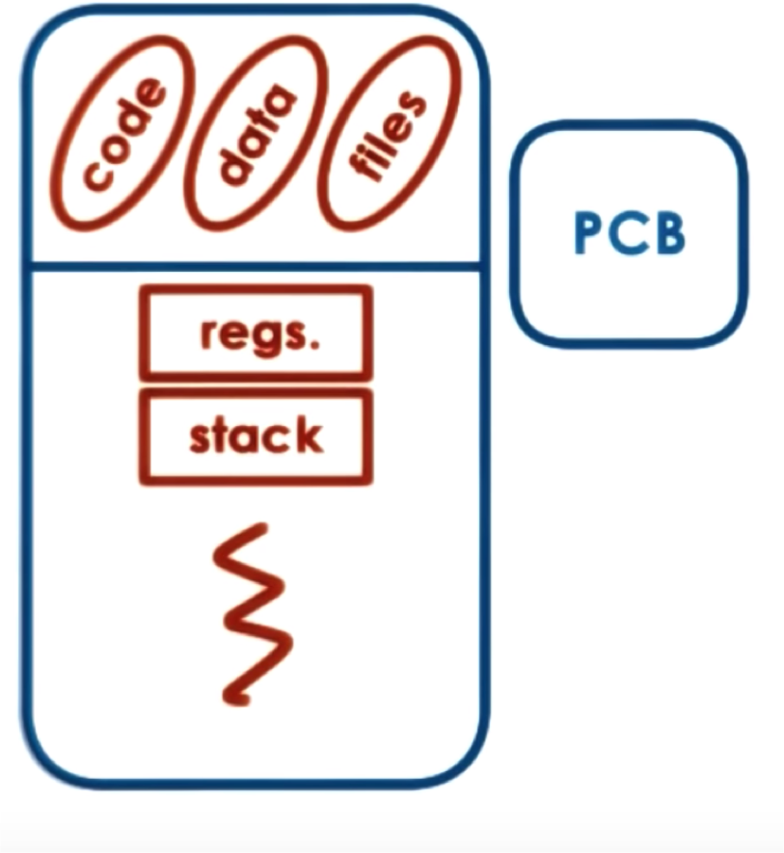
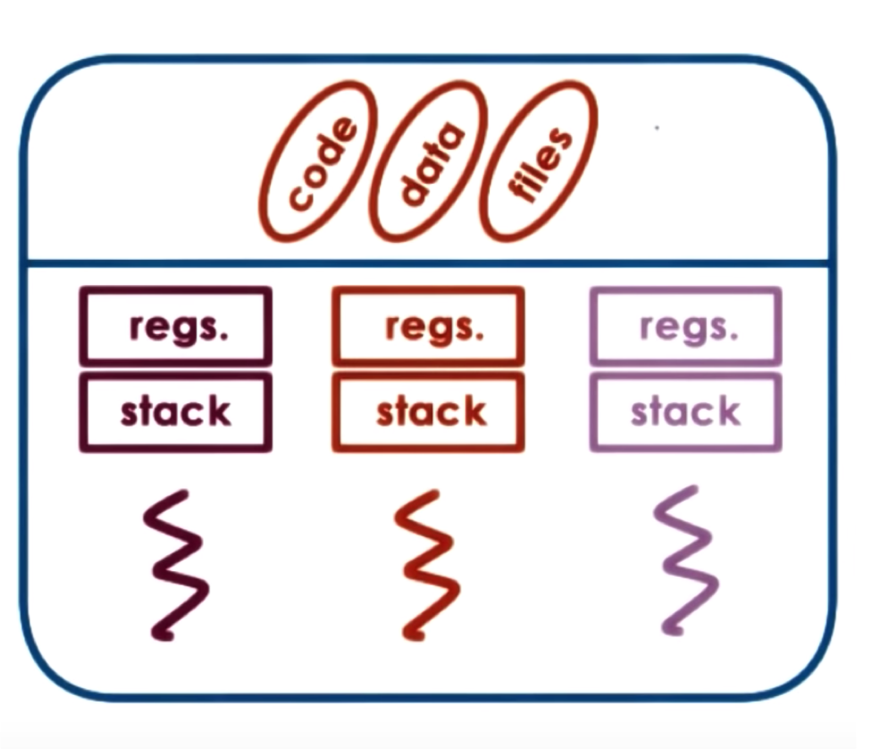
vs Threads
Process

Slide 30
Process vs Thread
Process | Thread
Executing instance of an application | Path of execution within a process
Used for heavy weight tasks | Used for small tasks
Takes more time for termination and creation and context switching | Takes less time for termination and creation and context switching
Process consume more resources. | Threads consume less resources
Process is isolated | Threads share memory

Slide 31
Week 4 – Checklist
Start PA2
Discuss processes vs threads
Read about IPC
32

